Slide 1
User guide

Slide 2
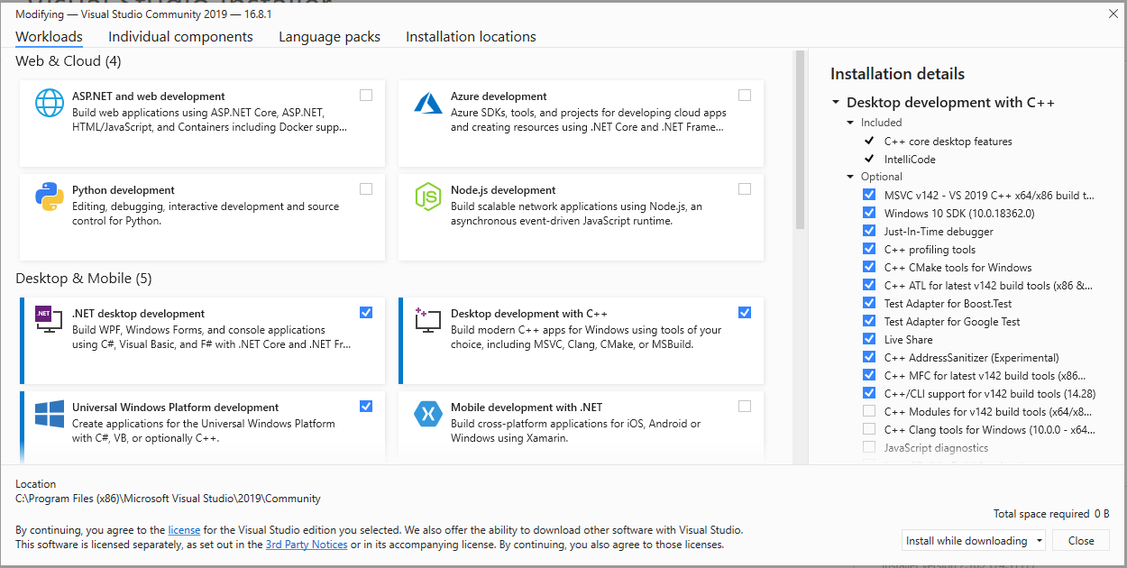
Installation prerequisite
Install visual studio and MFC ( recommend visual studio > 2017)
If we install visual studio for the first time or already installed it, simply type “visual studio installer” in window searching bar, please choose MFC option in visual studio installer. (the visual studio installer is included automatically when you download visual studio)

Slide 3
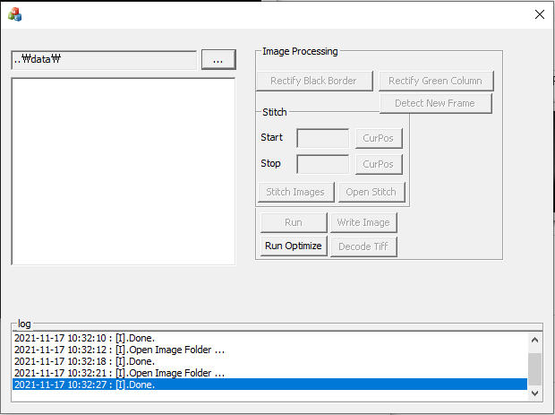
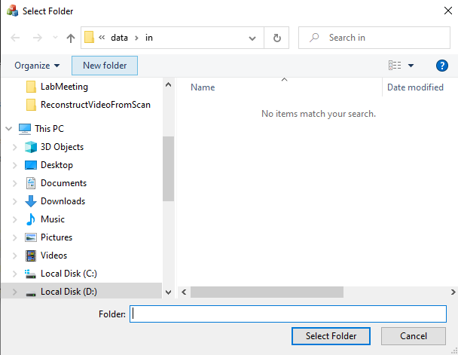
How to run
Step1: double click to ReconstructVideoFromScan.exe.
Step2: choose the folder contains .cri files.
Step3: Click “Run Optimize” button and wait until the program finish.
Step 1. Choose folder here
Step 1. Click here after navigating to folder contains .cri files

Slide 4
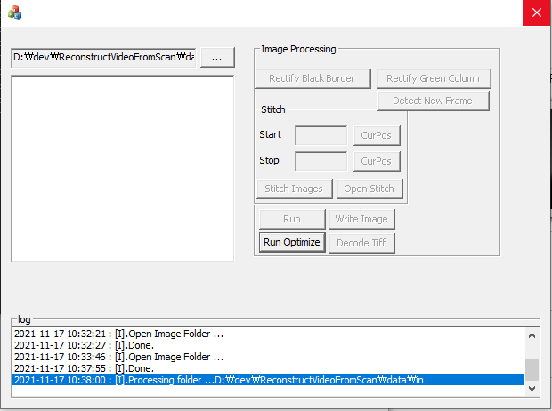
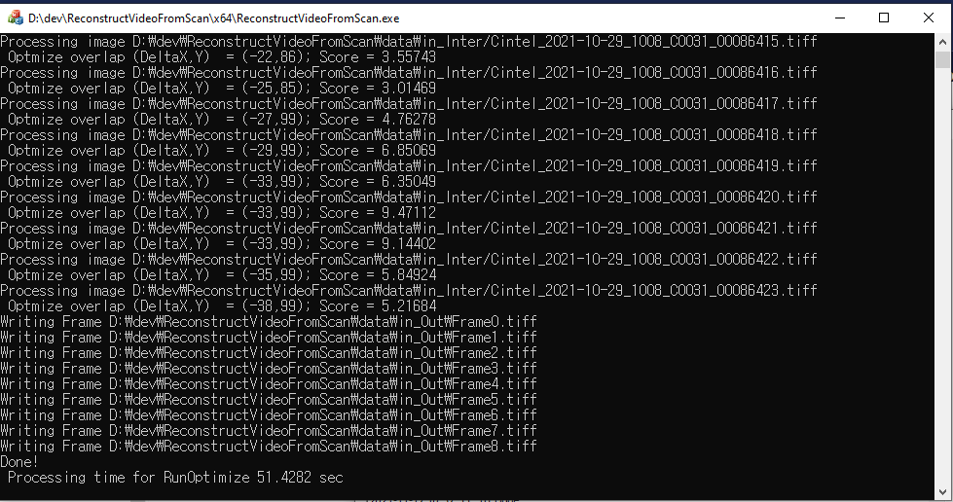
How to run
Step2. Click this button to process and wait until it finishes
Step2. Finish step 2 here

Slide 5
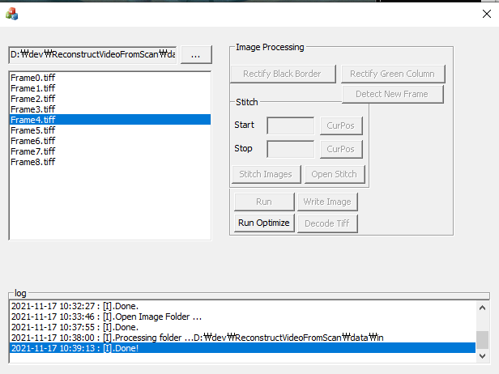
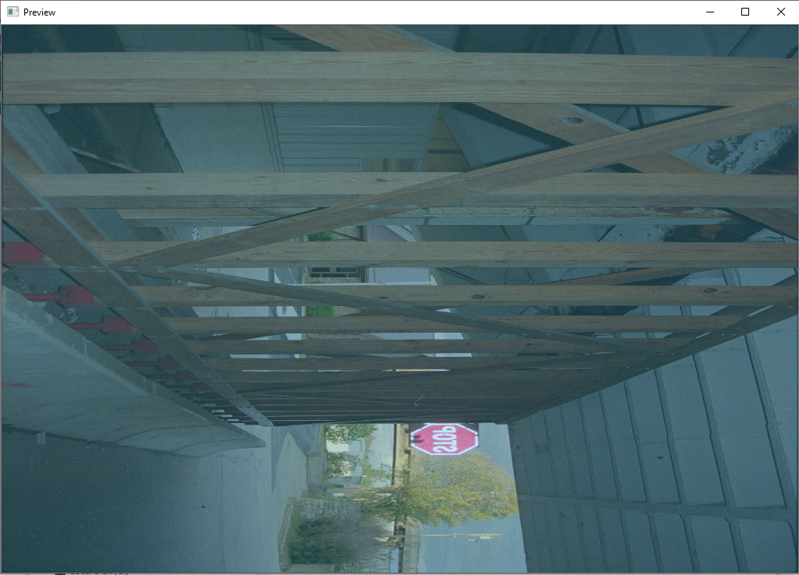
How to verify
- After running, the results will be shown in the left panel, to verify them, click any image and they will show up

Slide 6
How to verify
The output folder of result is placed in the same location with the input folder, for example, the path to input folder is C:\image\ →
The output folder will be C:\image_Out\
The intermediate result will be put at C:\image_Inter\

